Slide 1

Getting Feedback from Students:
Why UEQs are Not Effective,
Why I Do My Own, and
What I’ve Learned
Prof. David M. Schultz
Dept of Earth and Environmental Sciences
David.Schultz@manchester.ac.uk
@EloquentScience
Notes:
1

Slide 2
Many current UEQ questions are unsuitable for me to improve my teaching. (1)
“The feedback that I received on my work was helpful.”
Which one?
In what way?

Slide 3
Many current UEQ questions are unsuitable for me to improve my teaching. (2)
“This unit was well organised.”
Many factors affect the organisation—many are outside of my control.

Slide 4
Since 2010, I have created and administered my own end-of-semester evaluations.
my own tailored questions
during last lecture
on paper
information for improvement
response rate (70–90%)
written feedback

Slide 5
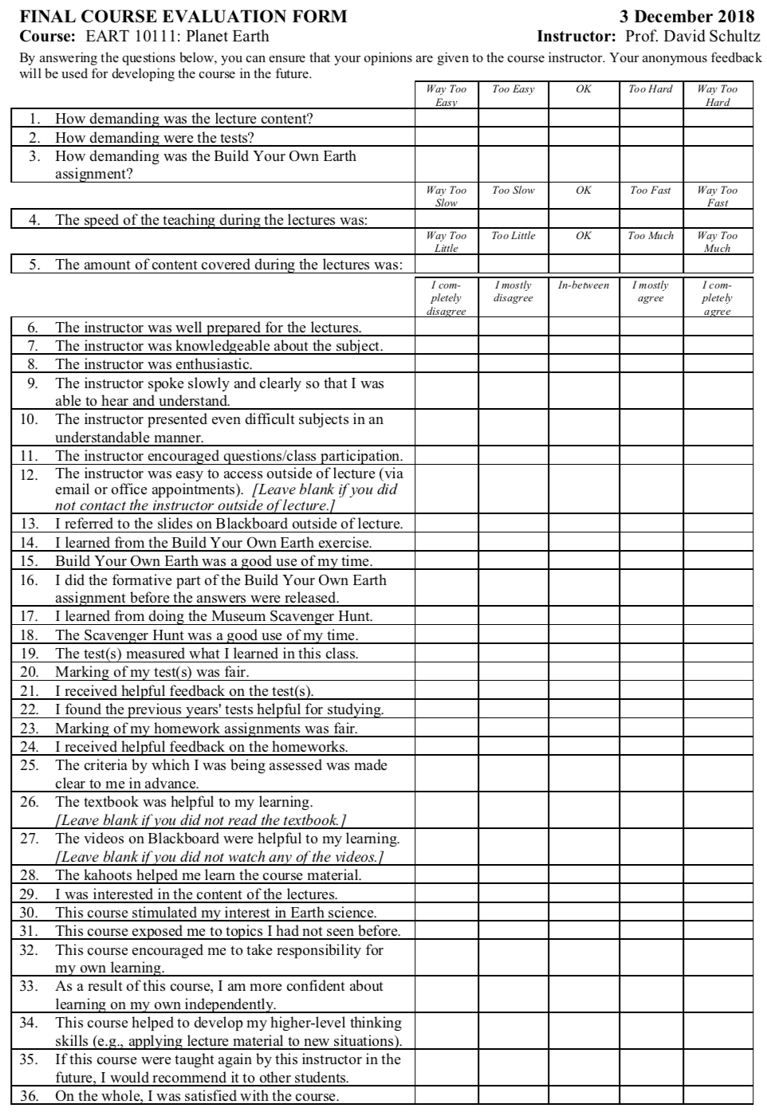
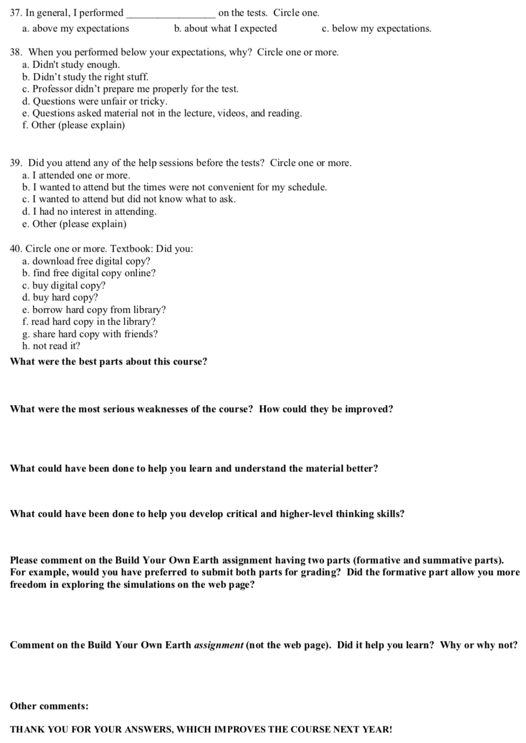
Multiple-Choice
Likert-Scale
Questions
Free-Text

Slide 6
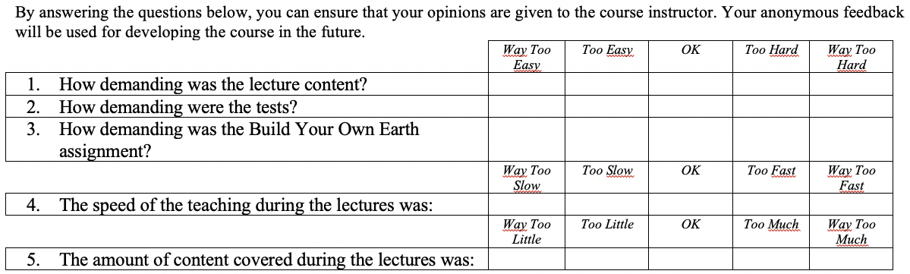
Questions help me judge course content and delivery.

Slide 7
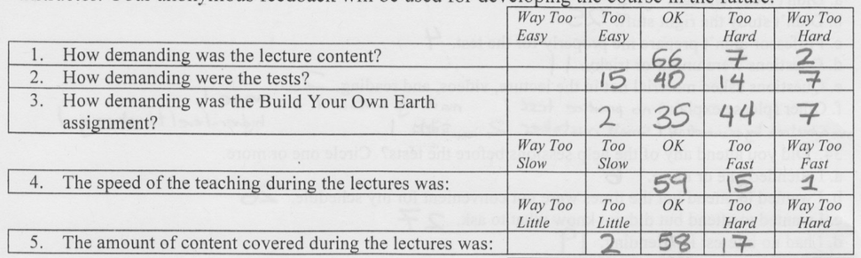
I aim to skew slightly hard, fast, and too much.
66
7
2
15
40
14
7
2
35
44
7
59
15
1
2
58
17
EART10111 Planet Earth, 2016–2017

Slide 8
Diverse student A-levels yield a broad distribution.
66
7
2
15
40
14
7
2
35
44
7
59
15
1
2
58
17
EART10111 Planet Earth, 2016–2017

Slide 9
Clearly, this assignment was too demanding.
66
7
2
15
40
14
7
2
35
44
7
59
15
1
2
58
17
EART10111 Planet Earth, 2016–2017

Slide 10
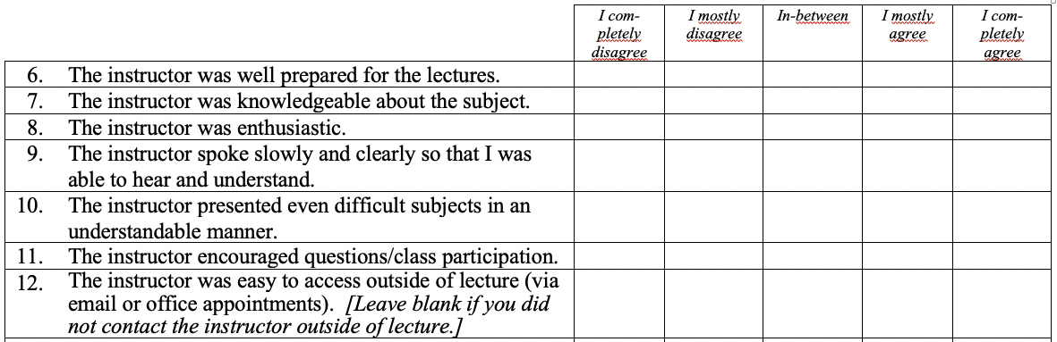
UEQs don’t ask any questions directly about me.
Notes:
UEQs don’t even ask about the instructor.

Slide 11
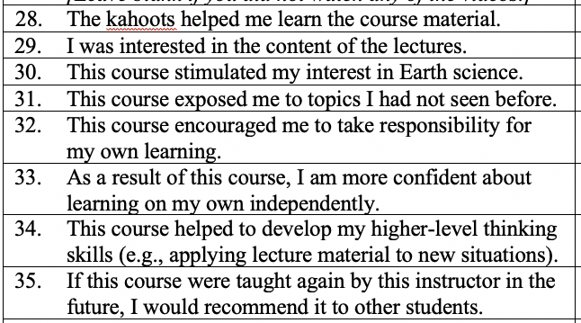
UEQs don’t help students reflect on their learning. (1)

Slide 12
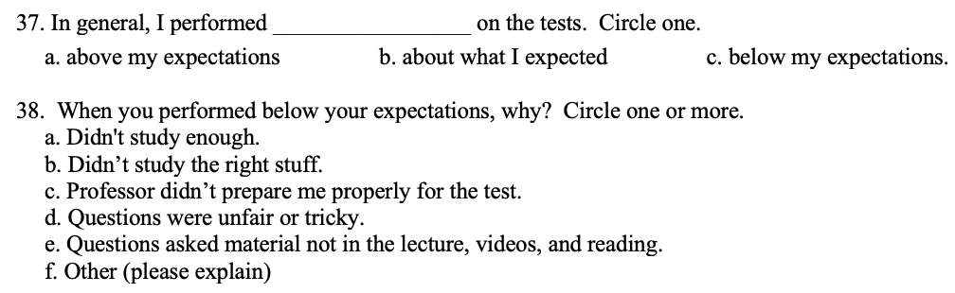
UEQs don’t help students reflect on their learning. (2)
Notes:
Since 2016

Slide 13
UEQs don’t help students reflect on their learning.
25
8
43
39
25
4
11
2
overwhelmed by new material
unfair marking none
sick
higher-level thinking
small mistakes
no practice tests
EART10111 Planet Earth, 2016–2017

Slide 14
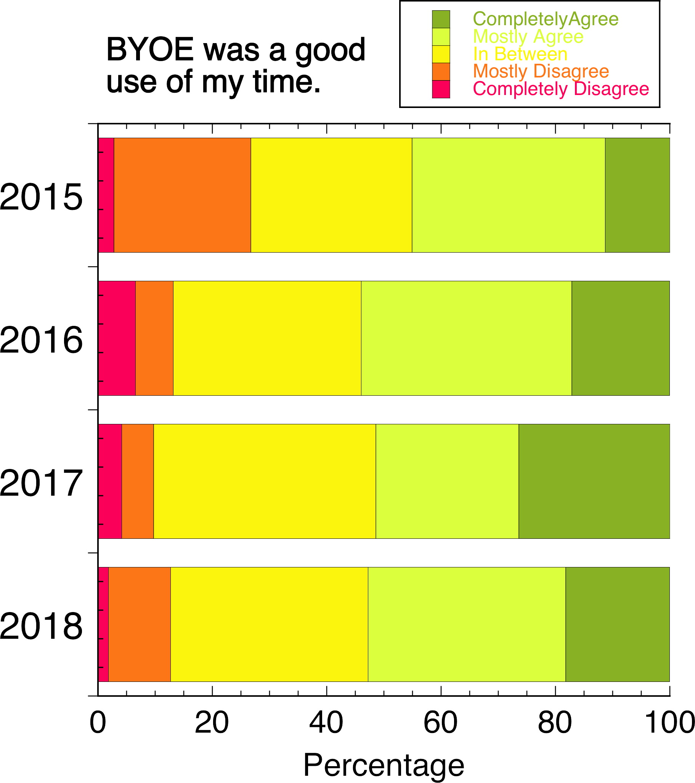
My questions help me
reflect on my teaching.

Slide 16
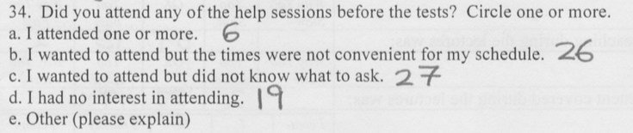
Why didn’t anyone attend my pre-test help sessions? 😭
EART10111 Planet Earth, 2016–2017

Slide 17
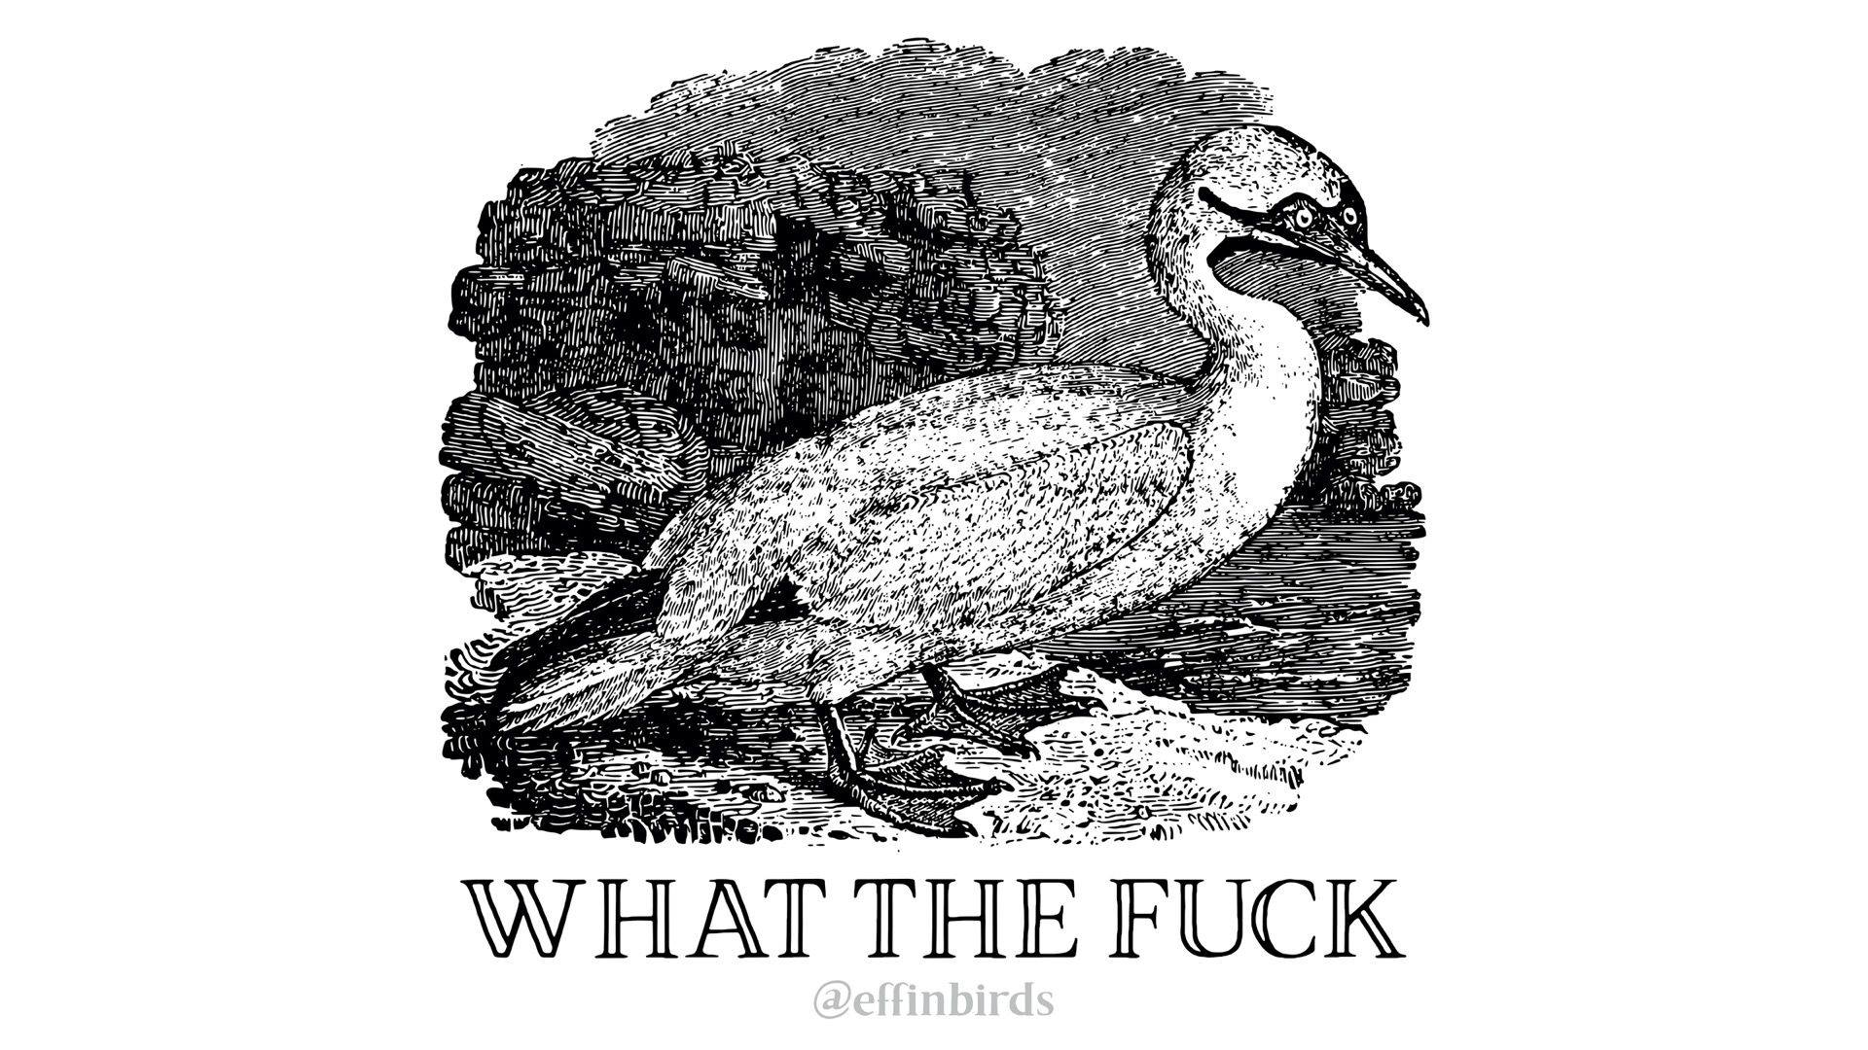
Why didn’t anyone attend my pre-test help sessions? 😭
***

Slide 18

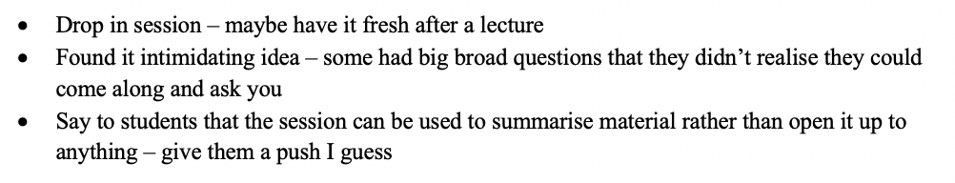
Focus group gets insight into why.

Slide 19
Lockdown 2020/2021
Qualtrics
Easy to write and administer
Despite survey in lecture, I lost response rate.

Slide 20
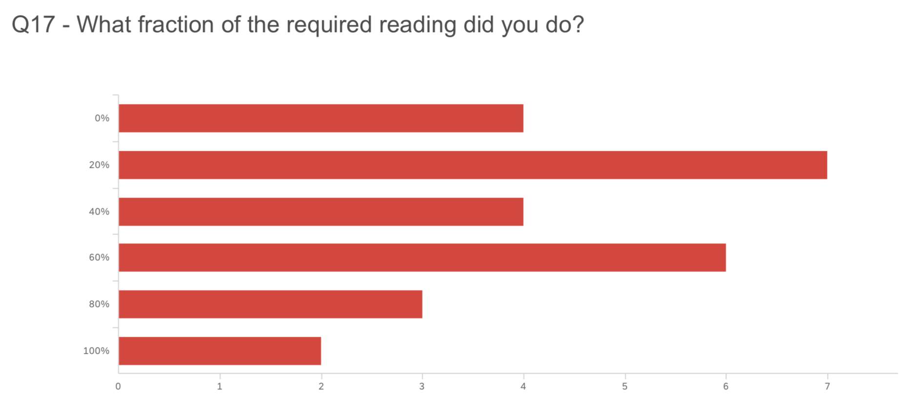
How were students managing pandemic studying?
0%
51%
20%
40%
60%
80%
31 responses of 107
100%
0
2
4
6
EART11100 A Dynamic Planet, 2020–2021

Slide 21
Reading was usually the first to go to help maintain student mental health.
There was a lot of reading which was daunting, i only thought it was there to
consolidate my knowledge if i needed to, I didn’t consider the possibility of being
tested on it. Also, i don’t know how to make notes on readings.
lack the attention span to read for hours, furthermore I already struggle with staring
at a screen too many hours of the day.
Not enough time to do both and the synchronous sessions
31 responses of 107
EART11100 A Dynamic Planet, 2020–2021

Slide 22
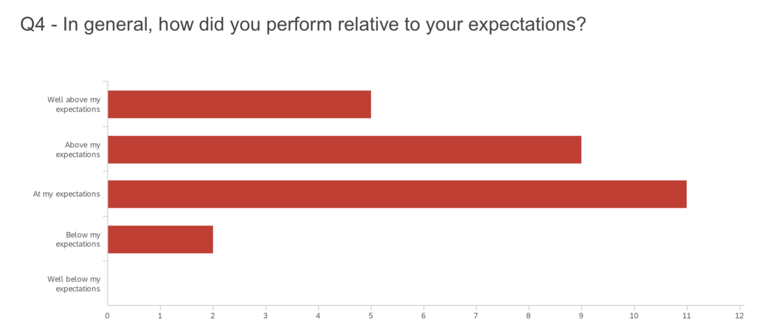
Best result of the year!
Well above my
expectations
51%
Above my
expectations
At my
expectations
Below my
expectations
Well below my
expectations
32 responses of 68
0
3
6
9
EART30310 Project Management and Professional Development, 2020–2021

Slide 23
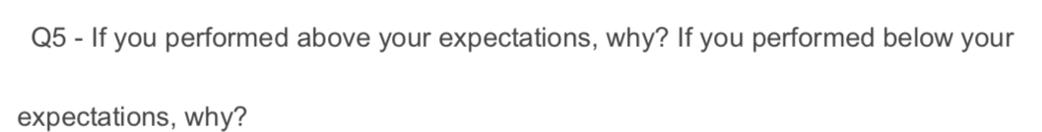
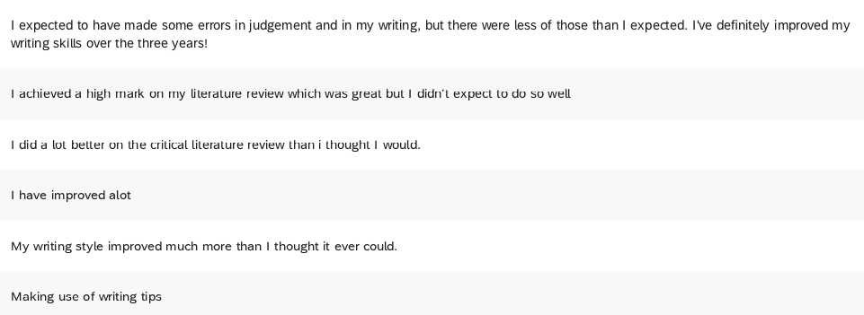
Best result of the year!
32 responses of 68
EART30310 Project Management and Professional Development, 2020–2021

Slide 24
Side Benefits!
Quotes for Teaching Excellence Awards and HEA Fellowship applications
Students appreciate knowing that the
instructor cares about improving the course

Slide 25
Feedback on your teaching is more than just UEQs.
Personalized surveys delivered in person:
More insight into my teaching
Better response rate
More detailed written responses
Focus groups add further information
Students recognize effort you’re putting in to improve their experience.
Contact me for examples: David.Schultz@manchester.ac.uk.

